Slide 1
Introduction to environmental health
Laban Sabiti
MPH, BScN, DCN,DES

Slide 2
Key concepts in environmental health
Health: state of complete physical, social, emotional and psychological wellbeing of an individual and not a mare absence of disease
Environmental health: is the study of how the environment affects human health.

Slide 3
WHO Definition of Environmental Health
Environmental health comprises those aspects of human health, including quality of life, that are determined by physical, biological, social, and psychosocial factors in the environment.
It also refers to the theory and practice of assessing, correcting, controlling, and preventing those factors in the environment that can potentially affect adversely the health of present and future generations.

Slide 4
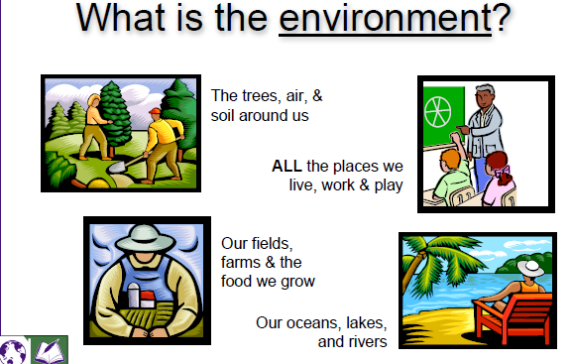
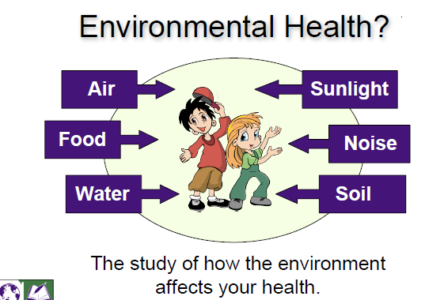
Environment and environmental health

Slide 5
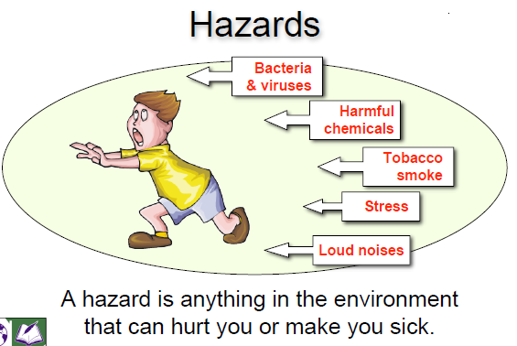
Concepts …..
Hazard: any thing in the environment that has potential to cause harm
Things in the environment that are harmful are called hazards
They include things like chemicals, disease-causing bacteria, loud noises and even stress.
Hazards can be natural or human-made.”

Slide 6
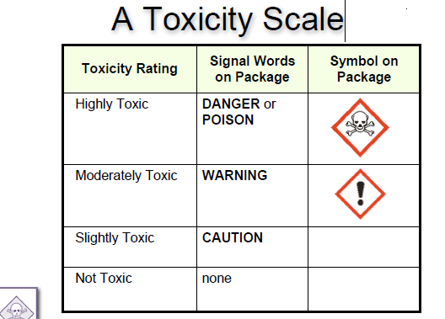
Concepts …..
Toxicity: is a measure of how dangerous a chemical is.
Toxicology is the study of how environmental hazards, such as natural and human-made chemicals, can enter our bodies and make us sick.

Slide 7
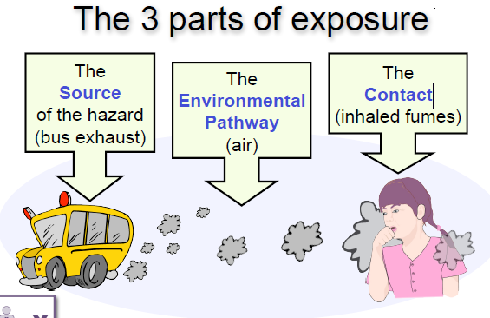
Concepts …..
Exposure: The total amount of a hazard that comes in direct contact with your body.
Exposure to a particular contact can take three forms/routes ie
Inhalation
Ingestion
Dermal absorption

Slide 8
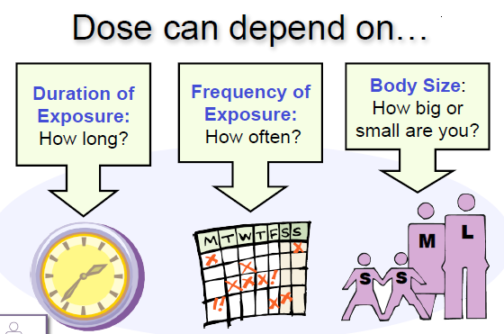
Concepts …..
Dose is the amount of a hazard that actually enters your body.
Dose is dependent on:
Duration of exposure
Frequency of exposure
Body size/ total surface area

Slide 9
Concepts …..
Individual susceptibility:
Some people are more likely than others to get sick when they are exposed to environmental hazards.
This might be because of their genetics, body size, age, gender or general health.
Examples of individuals who are more susceptible than others may include;
Pregnant women and their developing babies
Elderly people whose defense mechanisms are less efficient
Sick people who have weakened immune systems
Infants and children who are still developing

Slide 10
Concepts …..
Environmental Justice (EJ): means that everyone has a right to live in an environment that doesn’t make them sick, regardless of their race, culture, or income.
Unfortunately, some neighborhoods or communities are exposed to more environmental hazards than others, and may suffer higher rates of health
problems.
These communities often have less economic or political power in society when decisions are made.
For example, toxic waste dumps, polluting factories, and busy highways are often built in lower-income neighborhoods or communities of color. Communities recognize this as an environmental health issue and work to seek environmental justice

Slide 11
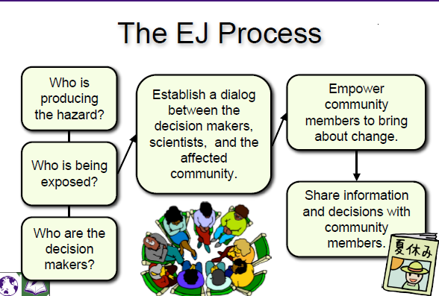

Slide 12
The eco system concept
An ecosystem refers to all of the organisms that live in a region and interact with each other and their surroundings
Its an integrated unit consisting of interacting plants, animals and microorganisms whose survival depends upon the maintenance and regulation of their biotic and biotic structures and functions.
With in an ecosystem are living and non living organisms ie the biotic and the abiotic structures

Slide 13
Biotic structures
These include plants, animals and microorganisms that have different nutritional behavior and status in the ecosystem and are accordingly known as producers and consumers based on how they get their food.
Producers
Green plants which can synthesize their food themselves by making uses of co2 present in the air and water in the present of sunlight by involving chlorophyll, the green pigment present in the leaves through the process of photosynthesis.
Organic matter produced through oxidation of certain chemicals in the absence of sunlight. Chemosynthetic organisms present in the earth’s core and released in the ocean’s depths.

Slide 14
Consumers:
All organisms which get their food by feeding upon other organisms
Herbivores: plant eaters
Carnivores: meat eagers
Omnivores : eat both meat and plants
Detritivores : feed on parts of dead organisms
Decomposers
Derive their nutrition by breaking down the complex organic molecules to simpler organic compounds and ultimately into organic nutrients – fungi and bacterial

Slide 15
Abiotic Structures
These are the physical and chemical components of an ecosystems eg climate, geographical factors, energy, nutrients and toxic substances
Physical factors – the sunlight and shade, intensity of solar flux, duration of the sun, average temperatures, annual rainfall, wind, latitude, soil type, water
chemical factors – availability of essential nutrients such as carbon, nitrogen, phosphorus, potassium, hydrogen, oxygen, and sulphur.

Slide 16
Functional attributes of an ecosystem
Food chain – the sequence of eating and being eaten
all organisms whether dead or alive are potential food for some other organisms and thus there is no waste in a functional ecosystem
Food web – network of food chains where different types of organisms are connected at different trophic levels so that there are a number of options of eating and being eaten at each trophic level

Slide 17
Significant of food chains and food webs
Energy flow and nutrient cycling takes place through food web and food chains
The ecological balance – population size
Biological magnification – pestcides and heavy metals that are non biodegradable, they can not decompose by microorganisms and they keep passing from one trophic level to another.

Slide 18
Energy flow in ecosystems
Energy follows two laws of thermodynamics
1st Law of thermodynamics – energy can neither be created nor destroyed but can be transformed from one form to another – the solar energy captured by green plants gets converted into biochemical energy of plants and later into that of consumers
2nd law of thermodynamics – it states that energy dissipates as it is used – gets converted from a more core concentrated to a dispersed form – thru respiration, locomotion, running, hunting etc

Slide 19
Major Ecosystem types
Here we consider types, characteristics, features, structure and function of some major ecosystems

Slide 20
Forest ecosystems
Tropical rain forest - Predominantly trees found near the equator; characterized by high temperature, humidity and rainfall all of which favour the growth of trees.
Tropical decidous forests - these are located far away from the equator, characterized by warm climate the year round. Rains occur only during monsoon, a large part of the year remains dry , trees loose their leaves during the dry spell

Slide 21
Tropical shrubs – found in arid and semi arid areas
Temperate rain forests – characterized with adequate rainfalls, dominated ever green broad leaved trees
Temperature decidous forests – found in areas with moderate temperatures, cold but not to severe winters and abundant rainfall throughout the year

Slide 22
Grasslands ecosystems
Grasslands are dominated by grass species but sometimes also allow the growth of a few trees and shrubs. Rainfall is average but erratic, limited grazing helps to improve net primary production while over grazing leads to degradation

Slide 23
Types
Tropical grasslands – They occur near the boarder Savannas with tropical rain forests in regions of high temperatures and low to moderate rainfall. characterized by tall trees with scattered scrubs and stunted trees
Temperate grasslands – usually found on flat, gentle sloped hills, intense grazing and summer fires do not allow shrubs or trees to grow
Polar grasslands ( Artic Tundra)- found in Arctic polar region where severe cold and strong winds along with ice and snow create hash climatic conditions for trees to grow

Slide 24
Desert Ecosystem
Occur in regions where evaporations exceeds precipitation (rainfall, snow etc) precipitation is less than 25cm per year (1/3 of the world land area is covered by deserts.
Tropical desserts – Namibia,
Temperate deserts – day time temperatures are very hot in the summer but cool in the winder
Cold deserts – eg Gobi in China

Slide 25
Aquatic ecosystems
Waters bodies and all their biotic communities present in them are either marine or fresh water
Pond ecosystem – small ecosystems where water is stagnant, usually shallow bodies,
Lake ecosystem – big fresh waters

Slide 26
Thank you very much

